Slide 1
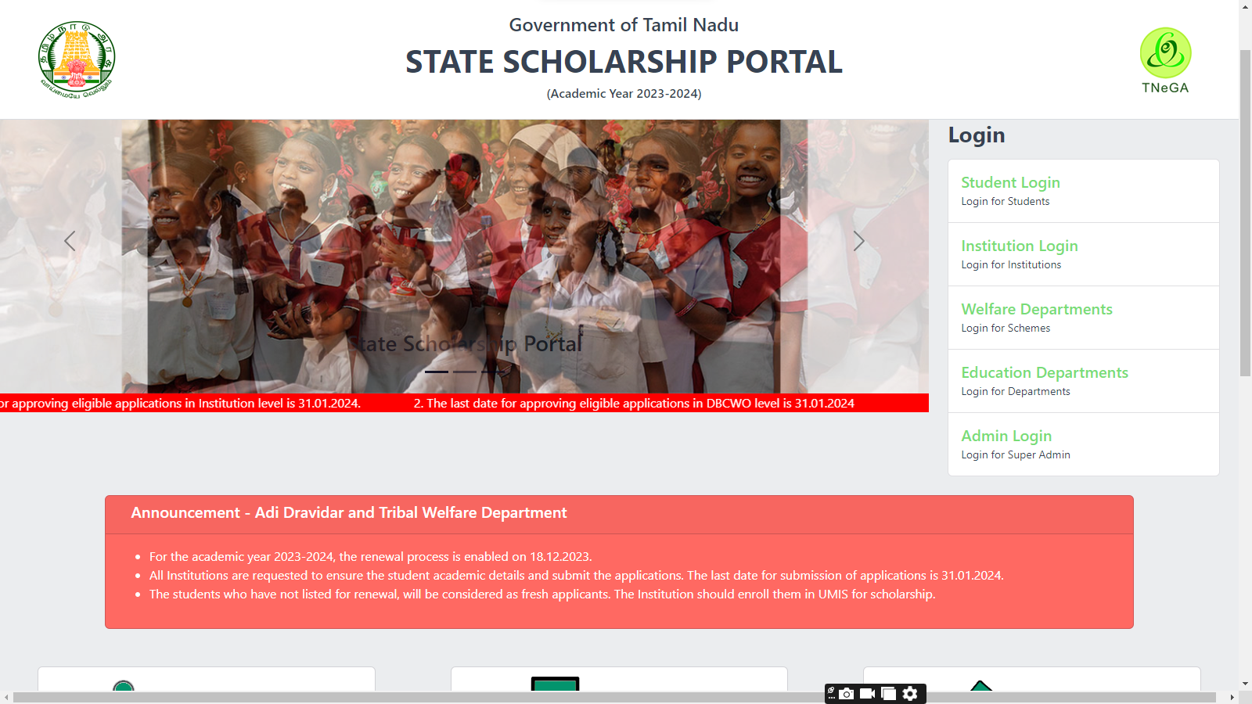
https://ssp.tn.gov.in/

Slide 2
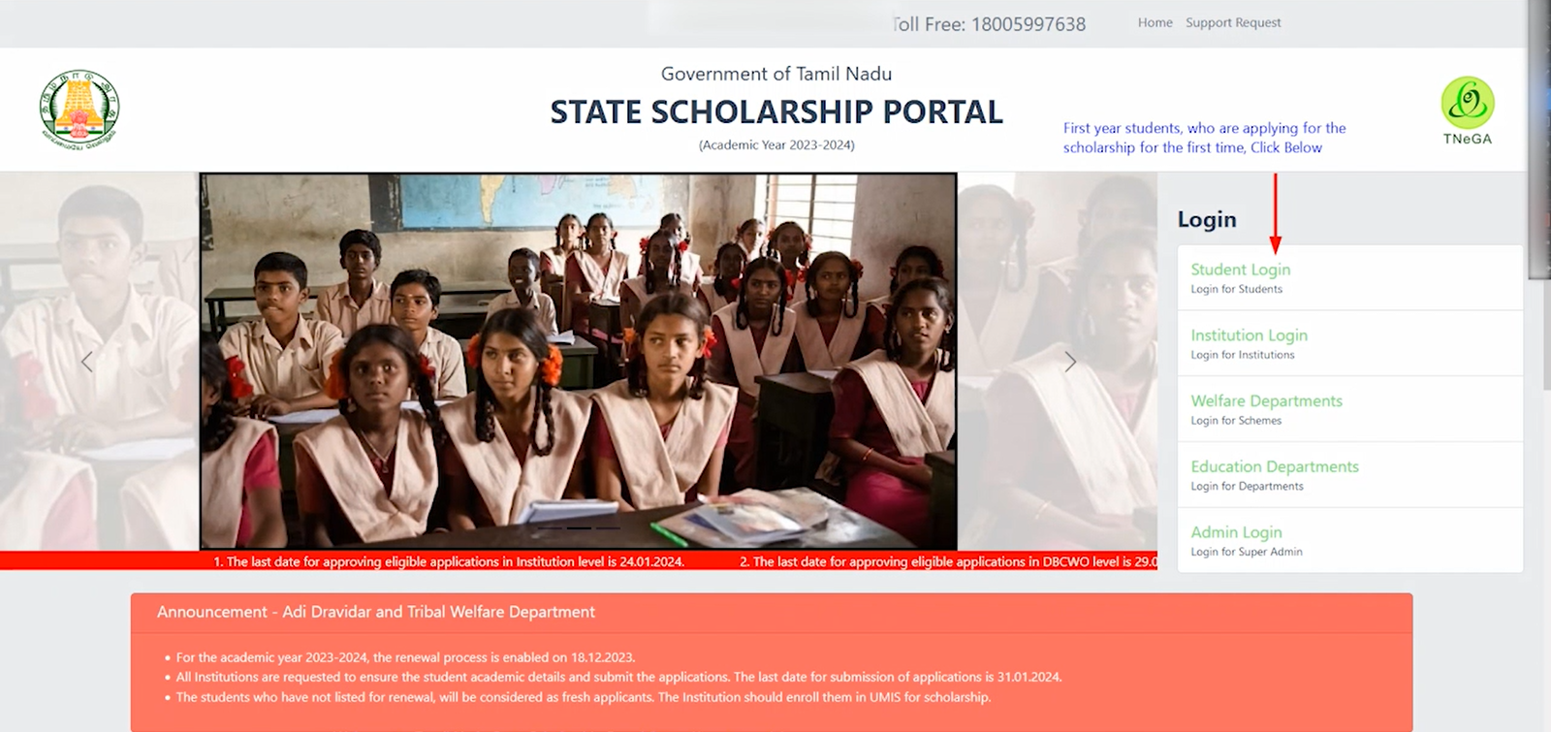

Slide 3
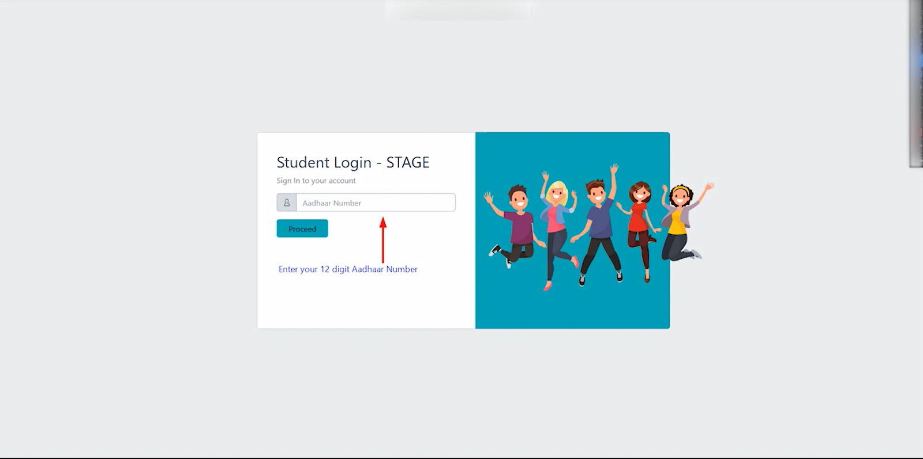

Slide 4
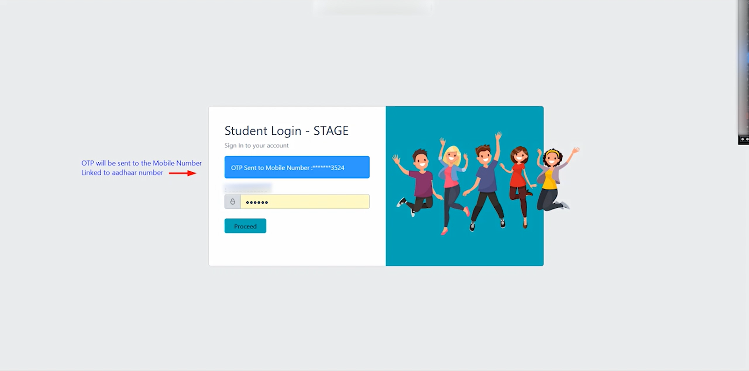

Slide 5
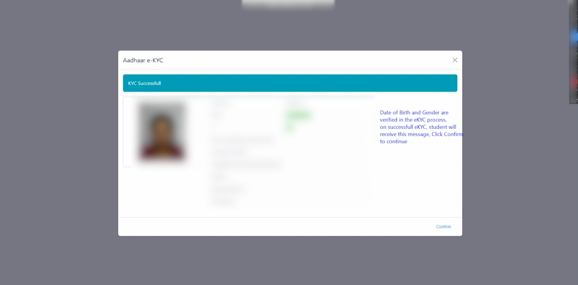

Slide 6
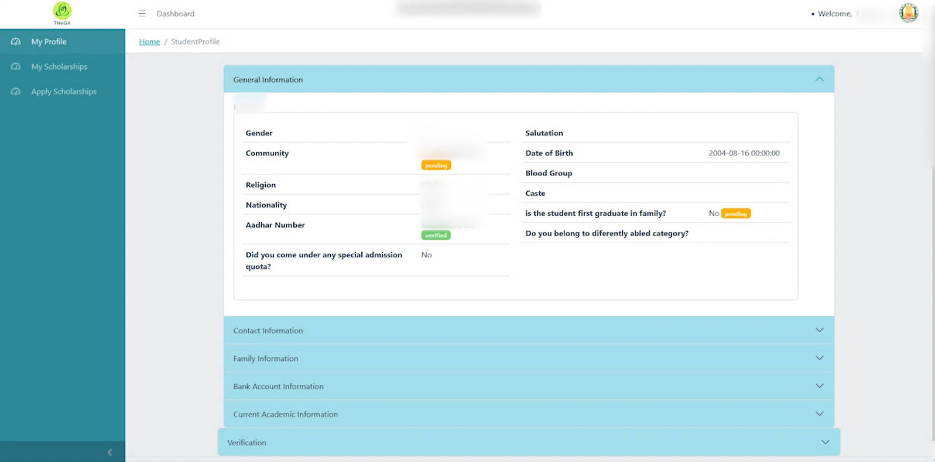

Slide 7
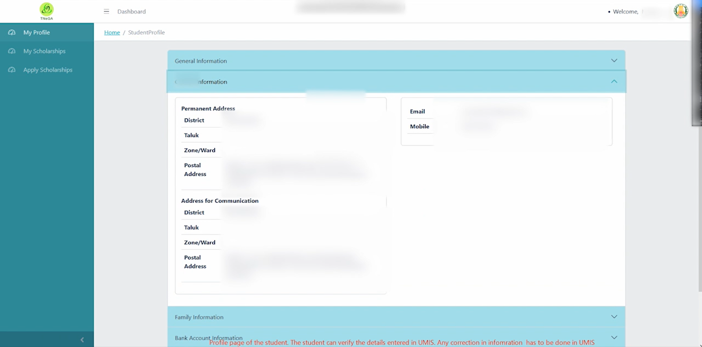

Slide 8
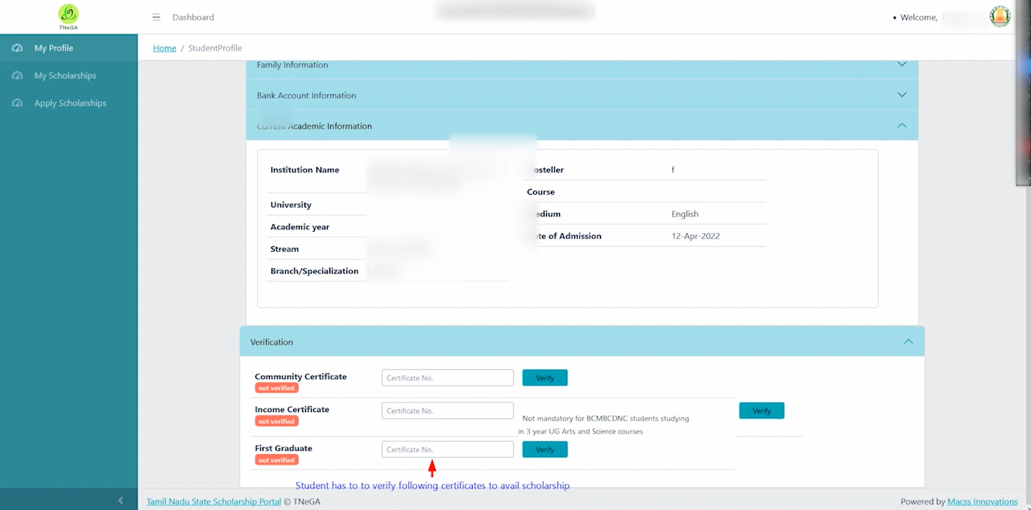

Slide 9
First Graduate student only verify the certificate. Others not mandatory

Slide 10
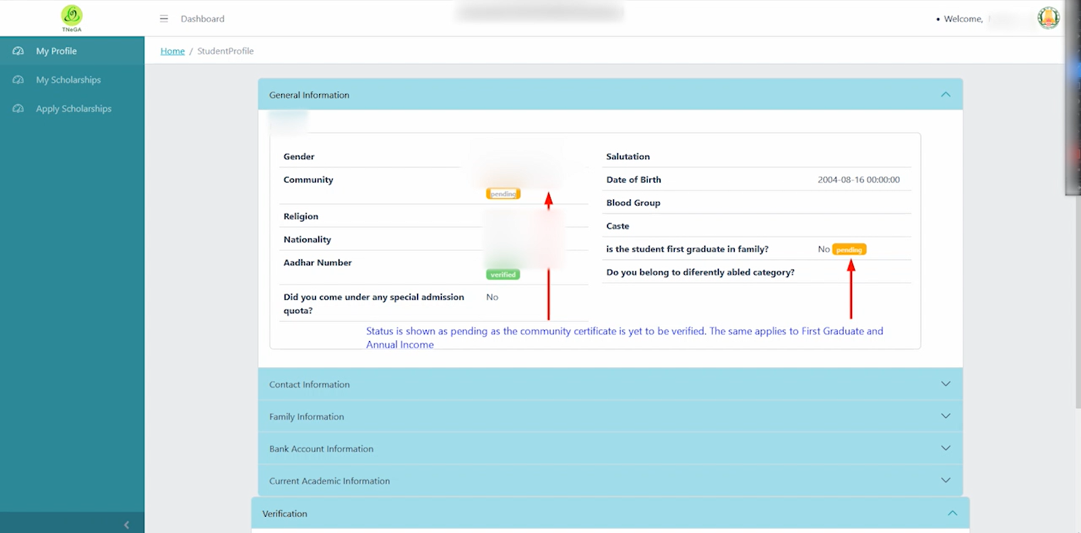

Slide 11
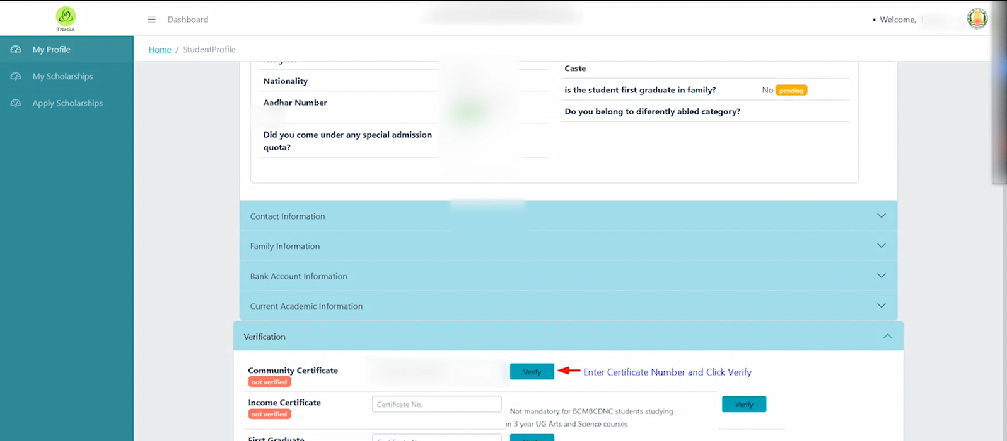

Slide 12
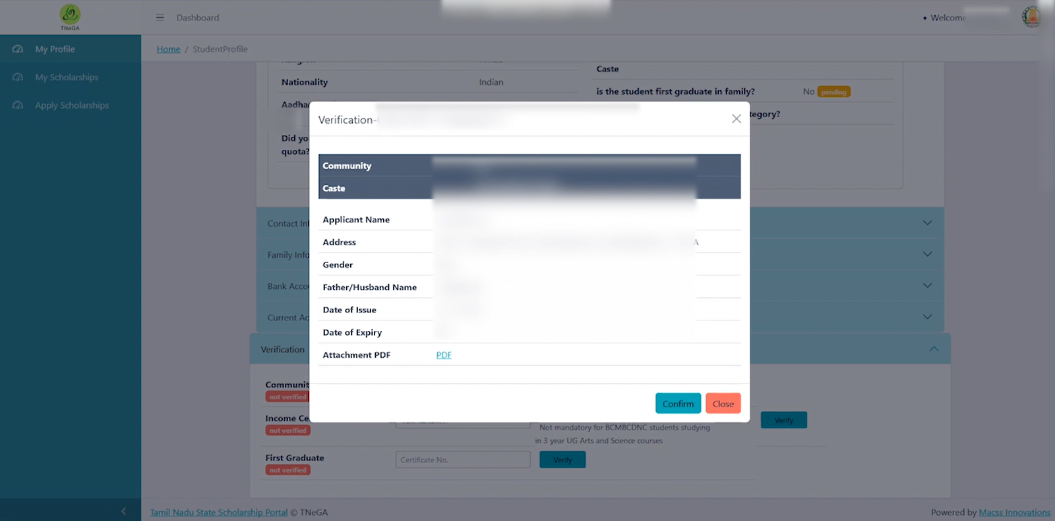

Slide 13
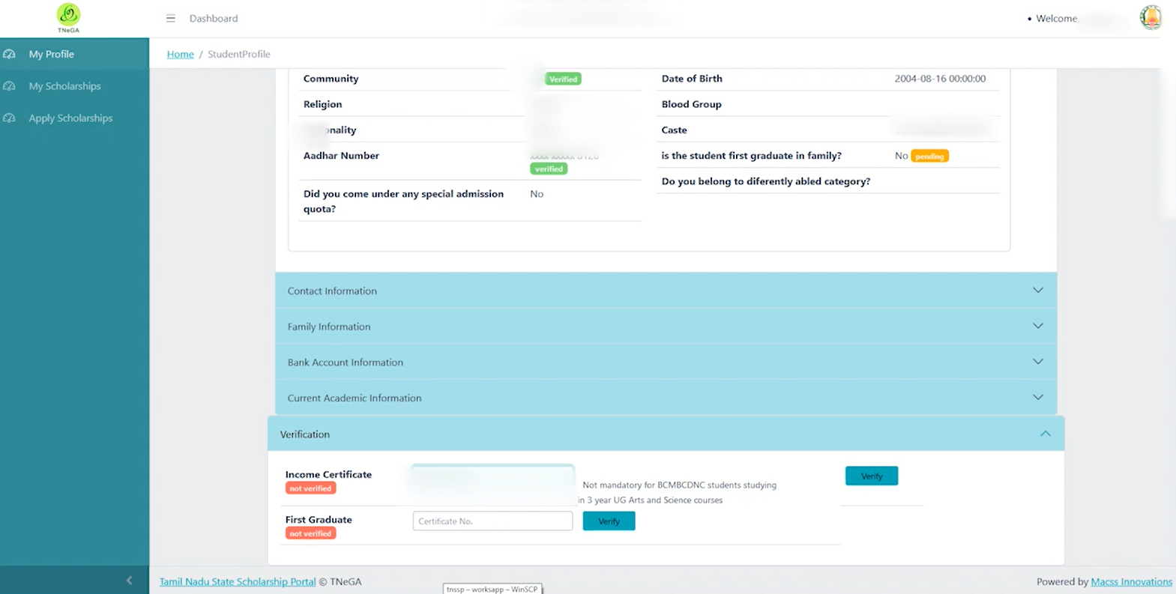

Slide 14
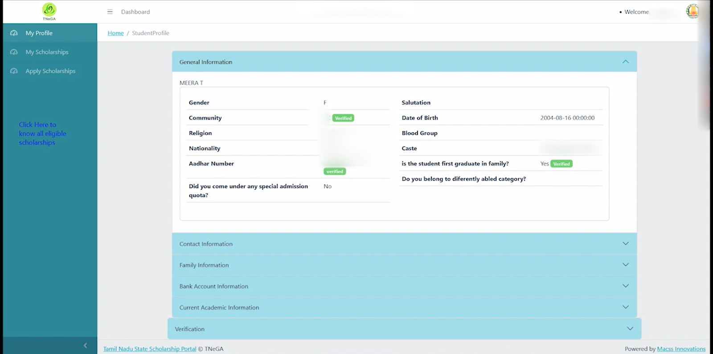

Slide 15
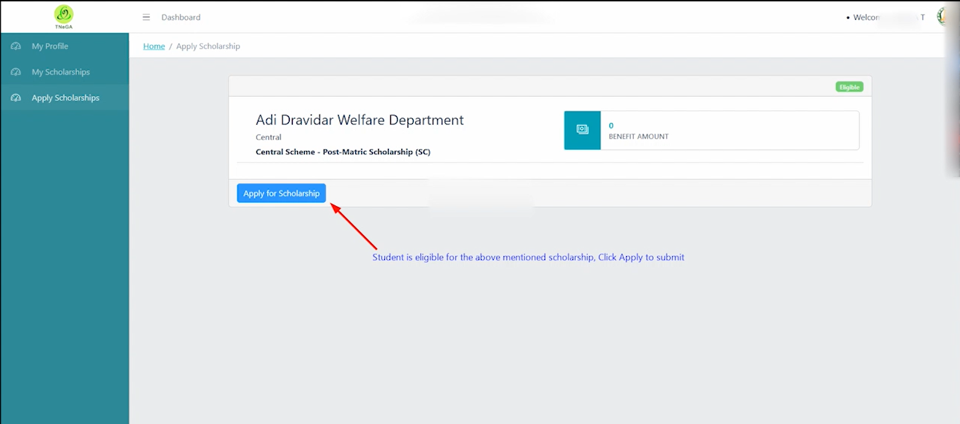

Slide 16
INCASE OF ANY DOUBTS REGRADING FRESHERS APPLICATION IN WEB PORTAL (L” Small Letter) DEPARTMENT MAIL ID:-(lsection.dadw@tn.gov.in) TOLL FREE NUMBER:1800 599 7638

Slide 17
THANK YOU…

